Slide 1
Modul 8: Instant Messaging
Using chat apps to report to iSIKHNAS

Slide 2
Requirements
Koneksi internet
Mail Server GMAIL
someone@gmail.com
some.body@gmail.com
E-mail account teregistrasi dalam iSIKHNAS

Slide 3
Akses
Desktop
G-Talk
Hangouts
Website
GMail
Smart Phone
Hangouts
IM⁺

Slide 4
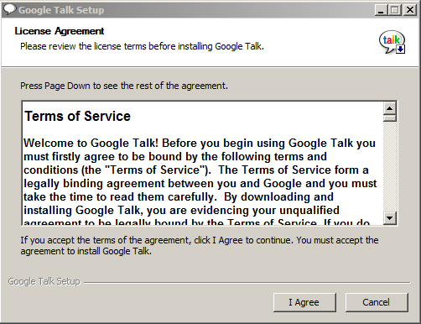
G-Talk
Install aplikasi G-talk

Slide 5
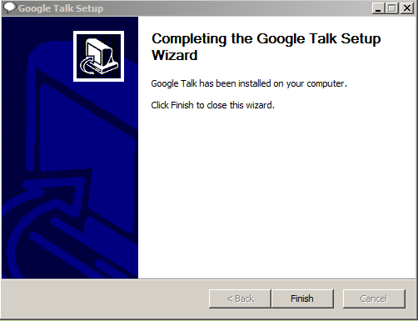
G-Talk
Selesai

Slide 6
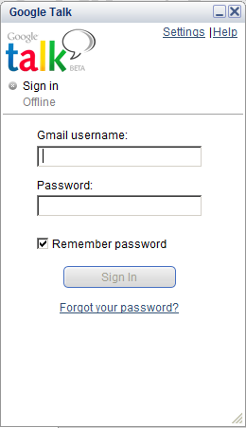
G-Talk
Isi username
Isi password
Sign In
1
2
3

Slide 7
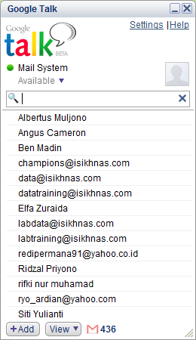
G-Talk
+Add

Slide 8
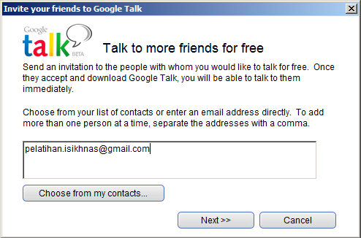
G-Talk

Slide 9
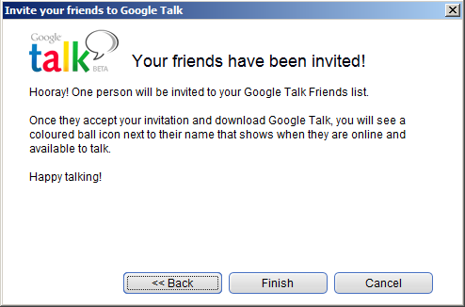
G-Talk

Slide 10
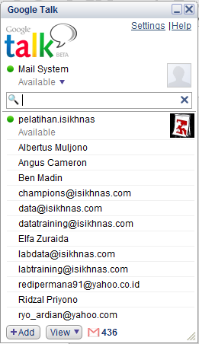
G-Talk

Slide 11
G-Talk
+Add

Slide 12
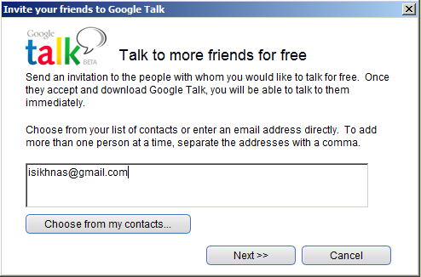
G-Talk

Slide 13
G-Talk

Slide 14
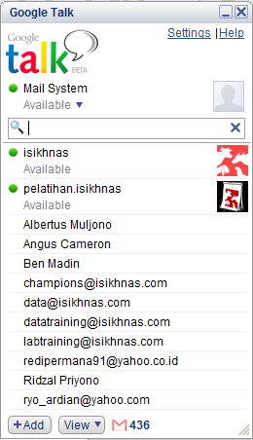
G-Talk

Slide 15
G-Talk

Slide 16
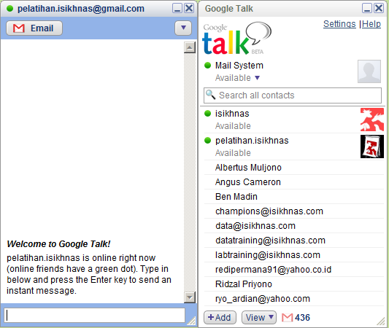
G-Talk

Slide 17
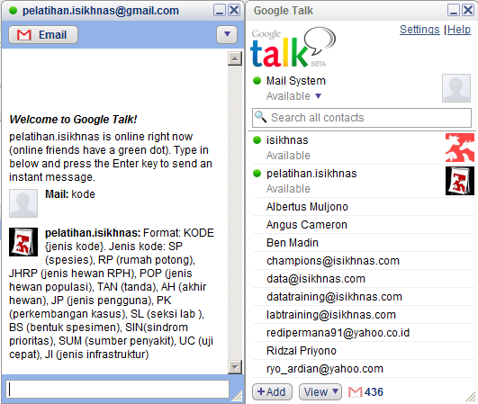
G-Talk

Slide 18
Hangouts
Install Hangouts
chrome.google.com/webstore

Slide 19
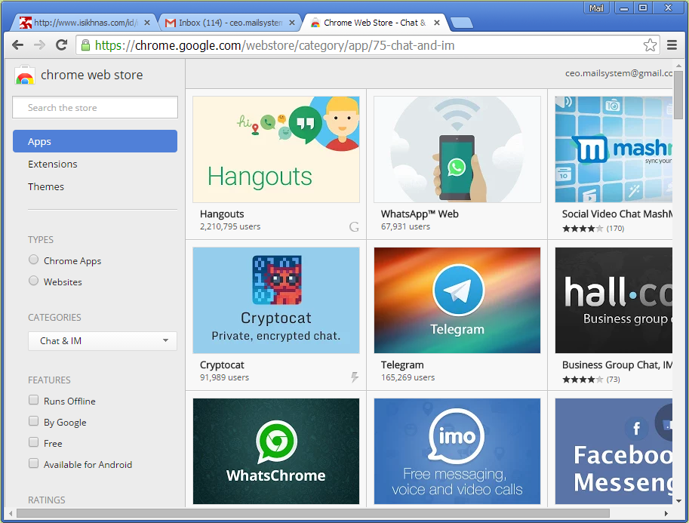
G-Talk
Isi username
Isi password
Sign In
1
2
3

Slide 20
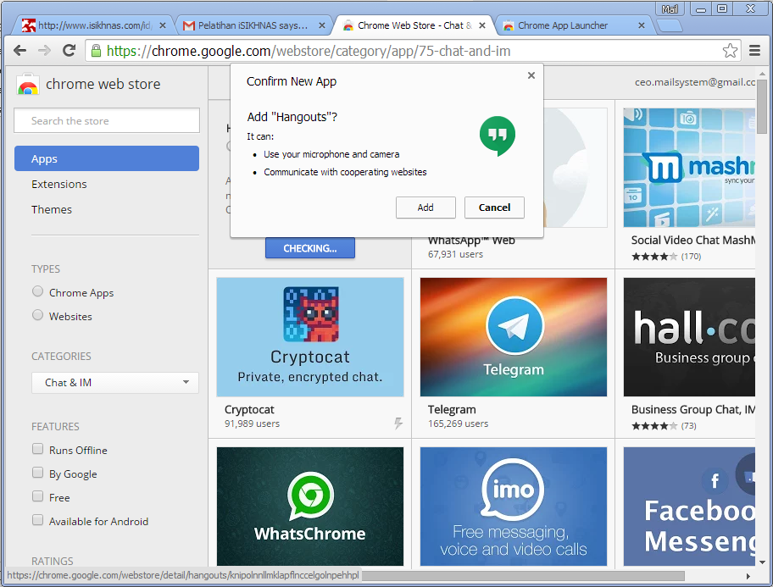
Hangouts
1
2

Slide 21
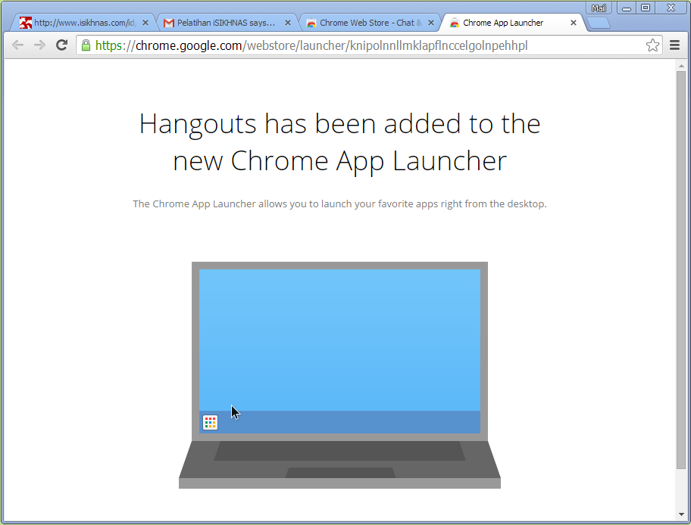
Hangouts
1
2

Slide 22
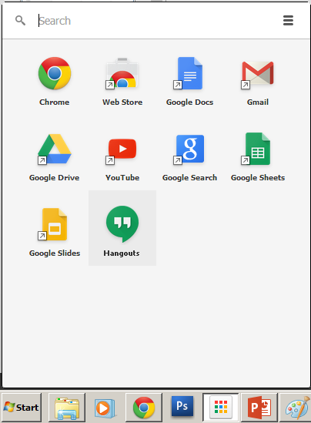
Hangouts

Slide 23
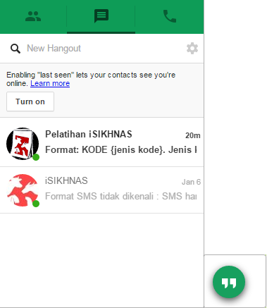
Hangouts

Slide 24
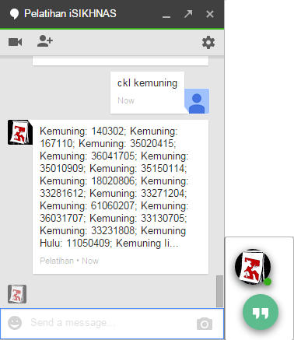
Hangouts

Slide 25
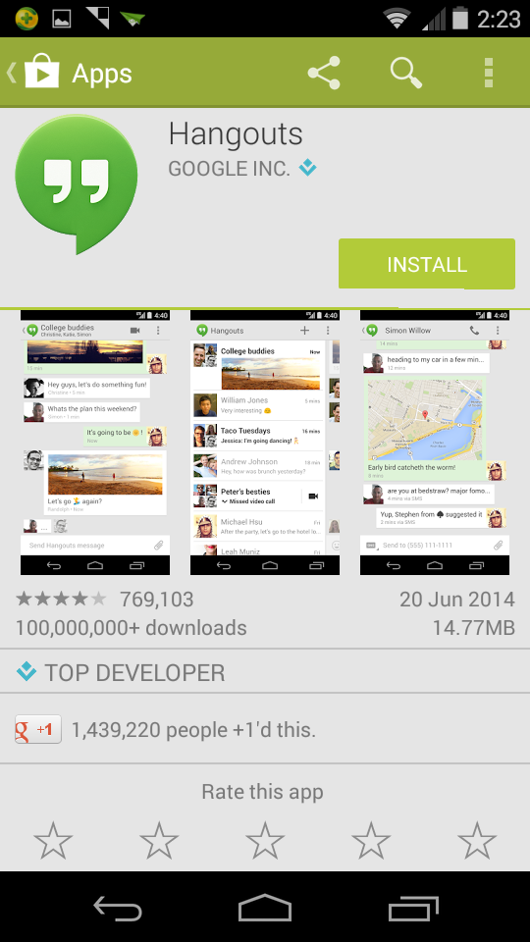
Hangouts Mobile

Slide 26
Terima kasih

