Slide 1
Basic Field Epidemiology
Session 7 – Transmission and spread of disease
Recorded PowerPoint file

Slide 2
In Session 7 we will explore:
How infectious agents move from one animal to another within a population
How infectious agents move between populations of animals
How infectious agents can survive or continue to occur in a population over time
Notes:
VOICE OVER
During this session we are going to look how infections get into and out of an individual, how infections can be maintained over time, and how they get between populations.

Slide 3
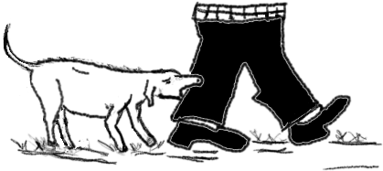
Rabies
Infected animal
Susceptible animal
Transmission
Transmission describes how an infectious agent can move from one animal to another
Notes:
VOICE OVER
We will introduce some concepts using rabies as an example.
When a dog with rabies bites another animal (or person) and infects it with rabies, this is an example of disease transmission – infection moving from one animal to another animal.
If there were only two dogs infected with rabies in a population and they both died without transmitting the disease to any other animals, the disease would disappear from that area.

Slide 4
How agents get out of the animal
Body surface – hair, pus or scabs (ringworm)
Nose secretions (influenza virus)
Mouth – saliva (rabies and foot and mouth viruses, tuberculosis)
Mammary – milk (bacteria causing mastitis)
Anus – faeces (salmonella bacteria)
Urogenital tract – urine and sperm (leptospirosis, campylobacter)
Eyes – tears (pinkeye)
Blood – (Q fever by tick vectors)
Notes:
VOICE OVER
In order for transmission to occur, an infectious agent must first leave the infected animal.
Some common ways are:
Through the body surface – such as hair, pus or scabs. A disease example is ringworm
Through the nose via secretions. A disease example is influenza virus
Through the mouth via saliva. Disease example include: foot and mouth disease and tuberculosis
Through the mammary gland via milk. Streptococcus bacteria which can cause mastitis use this way to get out of the body.
Through the anus via faeces. Salmonella bacteria and many parasites use this method.
Through the urogenital tract via urine and sperm. Leptospirosis exits via urine, and Campylobacter uses sperm to get out.
Through the eyes via tears. Moraxella bovis which causes pinkeye uses tears to get out of the animal.
Blood is used as a portal of exit by Q fever when it is spread by ticks.
Infectious disease agents can have more than way of getting out of the body.

Slide 5
How agents get into an animal
Oral – (parasites)
Respiratory
upper (influenza virus)
Lower (pneumonia in cattle – Mannheimia haemolytica)
Mucous membranes – (pinkeye)
Notes:
VOICE OVER
Then in order for transmission to occur, an infectious agent must gain entry into a susceptible animal.
Common portals of entry include:
Orally through ingestion. - Many parasites use to get into a new animal
Through the respiratory system by breathing the infectious agent into the upper airways, nose and throat.
Influenza virus can enter the host this way.
Additionally breathing the infectious agent into the lower airways and lungs like with Mannheimia haemolytic which is one cause of pneumonia in cattle
Through contact with mucous membranes of the eye, mouth or nose.
Moraxella bovis the infectious agent involved in pinkeye gains entry to the host through the mucous membranes of the eye

Slide 6
How agents get into an animal
Skin – (rabies)
Coitus – (brucellosis)
Iatrogenic – (bluetongue virus)
Notes:
VOICE OVER
Through contact with the skin.
Some infectious agents can infect a host through contact with intact skin such as ringworm.
Others infectious agents may require damaged skin (wounds or abrasions) to allow entry such as human anthrax.
Other infections are transmitted through the skin by biting insects or animal bites such as rabies
Through coitus, there are a number of infectious agents transmitted when animals breed. An example is brucellosis
Lastly infectious agents can be transmitted to a host iatrogenically.
This refers to transmission during some management or veterinary procedure (surgery, vaccination, dehorning, castration, injections) such as Bluetongue virus in animals or HIV/AIDS in humans

Slide 7
Type of contact between infected and susceptible animals during transmisison
Direct contact between animals
Infected animal sheds infectious agent in saliva, faeces, milk,…
Susceptible animal licks the infected animal and gets exposed
Calves may get infected with some diseases during pregnancy or from close contact with mother after birth
Notes:
VOICE OVER
Transmission of infectious agents has been classified into two groups:
Direct and Indirect
Direct transmission occurs when an infectious agent is passed from one animal to another by
Either by animal-to-animal contact
Or by one animal contacting infected discharge from another animal (nasal secretions, urine, faeces)
Or infection of young through the reproduction process such as the embryo in the pregnant uterus or through the milk

Slide 8
How agents get from one animal to another - Transmission
Transmission of infectious agents
Indirect
Living things (intermediate host)
Mosquitoes (Babesia in cattle, Malaria in humans)
Flies (pinkeye)
Non-living
Feed
Equipment
Clothing
Needles, syringes
Notes:
VOICE OVER
Indirect transmission is when another living or non-living thing passes the infection between animals.

Slide 9
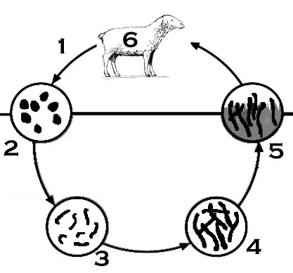
Life cycle diagrams
Eggs passed in faeces
1st stage larvae hatch from eggs in faeces
1st and 2nd stage larvae feed on bacteria in faecal pallets
3rd stage larvae is protected from drying out by its outer shell
3rd stage larvae move out of faeces and onto grass. The free living stage in the environment of the life cycle can take from 2 -12 weeks to complete
Notes:
VOICE OVER
Life cycle diagram can be used to represent transmission and maintenance pathways.
The Trichostrongylus spp. life cycle in sheep and cattle depict a direct transmission
Step 1 is eggs being passed in faeces
Steps 2, 3, 4 & 5 show numerous stages of larvae development in the environment.
A sheep then ingest grass and 3rd stage larvae. The method of entry into a new animal.
Once ingested the worms mature into adults and the cycle begins again.

Slide 10
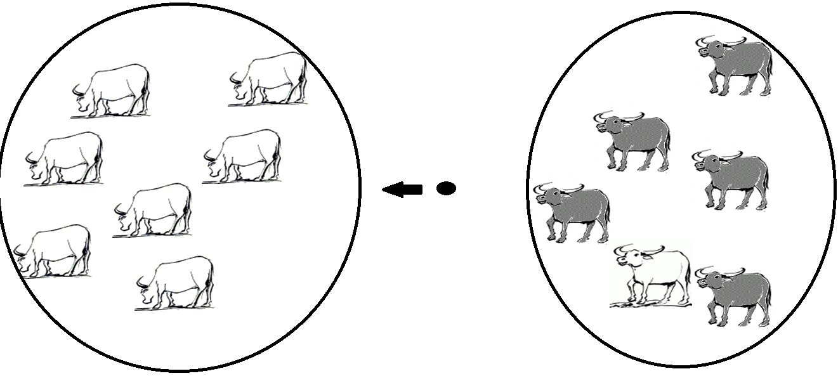
How disease gets between populations - Spread
Population 2 not infected
Population 1 (infected)
Infectious disease
Notes:
VOICE OVER
Spread of infectious agents between population of animals occurs commonly through:
Movement of infected animals into a new population
or
Movement of contaminated materials
or
Spread via contaminated equipment such as veterinary, farming, etc.
or
Movement of intermediate hosts between populations
or
Airborne spread of bacteria, viruses (foot and mouth disease), or fungi from one population to another

Slide 11
How infectious agents can survive or continue to occur - Maintenance
Maintenance of infectious agents
Rapid spread
Resistant form that can survive in the environment for long periods
Notes:
VOICE OVER
The anthrax example shows how a disease can maintain itself in the environment.
Maintenance refers to strategies developed by infectious agents to ensure that the agent continues to survive over time.
There are several strategies that infectious agents use for maintenance:
Some viruses depend on continual spread to susceptible host animal either through rapid infections that cause little immune response or by altering their genetic makeup to avoid immunity that may have developed to previous forms.
Some infectious agents develop resistant forms that are capable of surviving for long periods in the environment.
Such as Helminth eggs, Toxoplasma cysts, and anthrax spores.

Slide 12
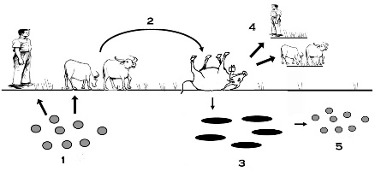
Life cycle diagrams
Anthrax spores are ingested, inhaled, or contacted by the host (human or animal)
Disease and death occur in the host
Vegetative cells are released into the environment following death of the host
Anthrax infection can occur from contact with animals that have died from anthrax
Vegetative cells in the environment turn into spores and remain infective to hosts for many years
Notes:
VOICE OVER
Back to our anthrax diagram,
After infection disease and death occur in the host
Then Step 3 illustrates vegetative cells are then released into the environment following death of the host
Step 4 shows Anthrax infection can occur from contact with animals that have died from anthrax
Step 5 shows Vegetative cells in the environment turn into spores and become infective to hosts
So anthrax uses spores as a method of maintenance to survive in the environment over a long period of time

Slide 13
How infectious agents can survive or continue to occur - Maintenance
Maintenance of infectious agents
Continual transmission
Resistant form that can survive in the environment for long periods
Persistent infections (carriers)
Ability to infect multiple- species
Notes:
VOICE OVER
Some infectious agents form persistent infections in host animals allowing survival for long periods. Johnes disease, Tapeworm, MaediVisna virus, and BVD are examples of this.
Variations of this strategy include
Carrier states where animals are infected and may shed the infectious agent for prolonged periods but show little evidence of disease. Like with Salmonellosis.
Latent infections occur when an animal may be infected but not show signs of disease and then have signs of disease or shedding recur at some future date, often following stress. Herpes virus is an example that uses this strategy.
Other infectious agents have developed the capacity to infect multiple different species of hosts to increase likelihood of survival over time. These agents include Nipah virus, SARS, and Rabies.

Slide 14
Session 7 - Summary
Transmission describes how an infectious agent can move from one animal to another
Spread describes how an infectious agent moves from one population to another
Maintenance refers to how an infectious agent can survive or continue to occur in a population over time
Notes:
VOICE OVER
During this session we looked at the different methods that infectious agents use to get between animals and populations and the types of strategies they use to survive over time.

Slide 15
Close of video

