Slide 1
Basic Field Epidemiology
Session 10 – Making sense of the information you collect
Recorded PowerPoint file

Slide 2
In Session 10 we will explore:
How to describe patterns of disease by
Time
Place
Animal
How to use this information to think about causes and control strategies
Notes:
VOICE OVER
During this session we are going to look at how to describe patterns of disease, the different types of control strategies and how to use them.

Slide 3
Budi’s place
2 cows have diarrhoea
Many cases reported to iSIKHNAS in the village the calf came from
Many cases have been reported in the next Kabupaten where the drain runs
Notes:
VOICE OVER
Pak Paimin finds there have been lots of reported diarrhoea cases in the village where the calf came from and also in the next Kabupaten where the drain runs to from Budi farm.

Slide 4
Describing patterns of disease
Count cases and non-cases
Describe these in terms of:
Time
Animal
Place
This understanding of disease will help us to develop control strategies
Notes:
VOICE OVER
Epidemiology studies patterns of disease occurrence.
To find the patterns we need to count cases and non-cases.
These counts can be used to describe disease occurrence in terms of time, place, and animal.
Doing this will help us understand the disease, its impact, and explain how and why the disease occurred. This will help develop control strategies.

Slide 5
Budi’s place
Notes:
VOICE OVER
Pak Paimin alerts the DINAS vet and together they create the epidemic curve.
This helps them to start thinking about the pattern of disease in relation to time and how to conduct a more detailed investigation together.

Slide 6
Describing patterns of disease by Time
Notes:
VOICE OVER
When describing patterns of disease by time we generally use epidemic curves.
An epidemic curve are a simple plot of the count of new cases of disease over the time of onset of clinical signs. This is generally the day or date when clinical signs were first detected.
Epidemic curves can provide a lot of information about the disease under investigation.
This epi-curve is probably from a highly contagious diseases as it has a steep rise followed by a progressive decline as susceptible animals are exhausted in the population.

Slide 7
Describing patterns of disease by Time
Notes:
VOICE OVER
This epi-curve is probably from a disease outbreak associated with point exposure of animals as it shows a sharp rise in cases and then a sharp fall.

Slide 8
Describing patterns of disease by Time
Notes:
VOICE OVER
This epi-curve is probably from a disease an endemic diseases that is not very contagious as it shows a fairly level pattern with some small peaks and troughs but no large rises.

Slide 9
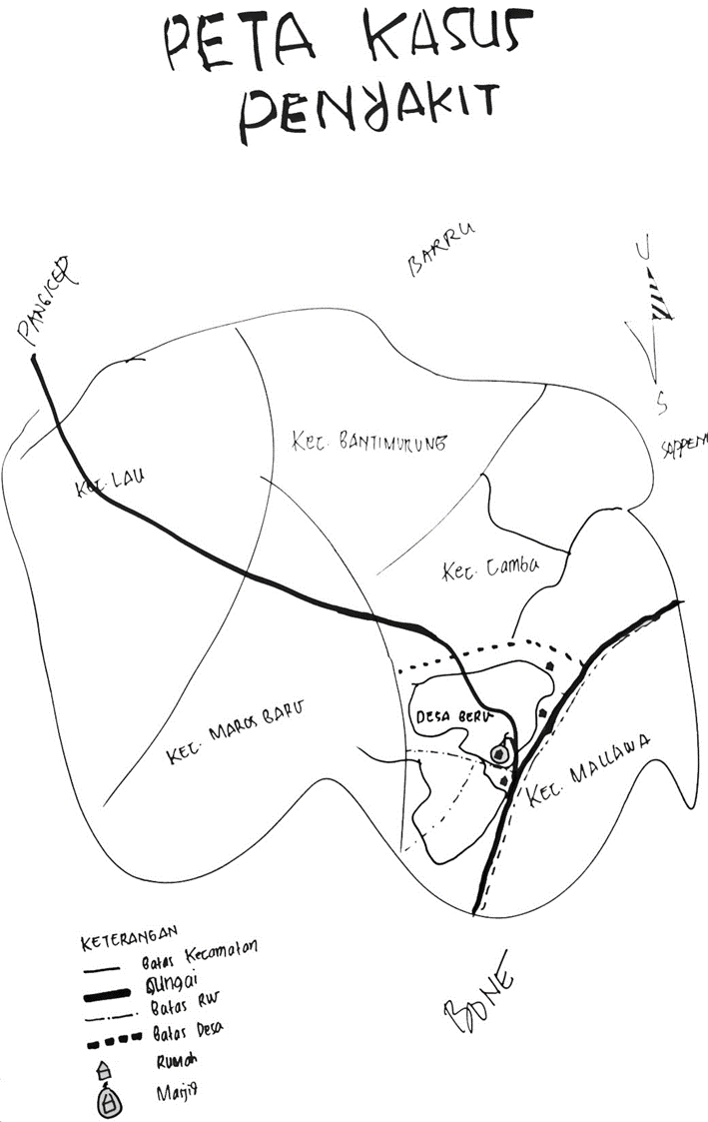
Budi’s place
Notes:
VOICE OVER
Puk Paimin and the Dinas vet look at the spatial distribution of the reported cases from iSIKHNAS.
This shows a clear line of cases that follow the drain through the neighbouring Kabupaten.

Slide 10
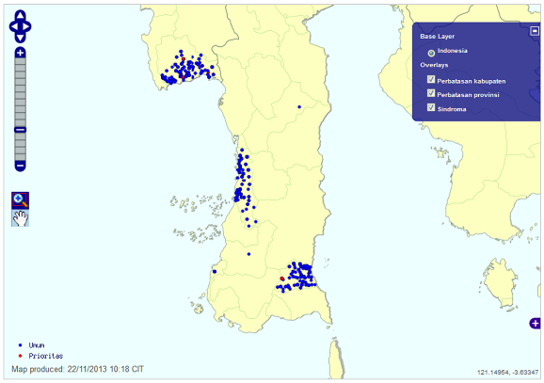
Describing patterns of disease by Place
Notes:
VOICE OVER
Describing disease occurrence by place is usually done by mapping.
Modern epidemiologists may often turn to computer based mapping software.
Simple, hand-drawn maps remain very useful as summary descriptions of disease occurrence

Slide 11
Describing patterns of disease by Animal
Common characteristics used to describe disease occurrence by animal are:
age group
breed
species
sex
body condition
vaccination status
Notes:
VOICE OVER
Describing disease occurrence by animal is usually done by arranging counts of cases by some host characteristic.
Common characteristics used to describe disease occurrence by animal are:
age group
breed
species
sex
body condition
vaccination status
Sometimes description of outcome are included like number infected, number recovered, number died for each reported characteristic.

Slide 12
Describing patterns of disease by Animal
Proportions
Number of cases of disease
$Proportion=\frac{numerator}{denominator}$
$Proportion=\frac{number of cases}{denominator}$
Notes:
VOICE OVER
Often descriptions of disease occurrence are more useful expressed as a proportion.
To calculate a proportion you will need to count two different groups of animals:
Firstly the number of cases of disease - This can be either expressed as the number of new cases over time or the number of cases at a point in time.
Remember to use a case definition when conducting an epidemiological investigation.
So the number of cases forms the numerator in calculation of the proportion.

Slide 13
Describing patterns of disease by Animal
Proportions
Population-at-risk
$Proportion=\frac{numerator}{denominator}$
$Proportion=\frac{numerator}{population−at−risk}$
Notes:
VOICE OVER
Now we need to count or estimate the number of animals that are considered eligible to get infected with the disease.
This is called the population at risk and forms the denominator in a proportion.
The population at risk should include all those animals in the area of interest (farm, village, regency, province etc.) that could get the disease.
This may not include every animal.
Let’s look at some examples of different populations at risk:
In an outbreak of Milk Fever (Calcium deficiency) in cattle, the population-at-risk is all pregnant female cattle on the farm.
Male cattle, and non-pregnant females are not part of the population-at-risk.
The population-at-risk for retained placenta would be all cows and heifers which calve in the herd.

Slide 14
Describing patterns of disease by Animal
Proportions
$Proportion=\frac{number of cases}{population−at−risk}$
Attack rates are a type of proportion used to compare disease between groups
Notes:
VOICE OVER
Describing disease occurrence using proportions may help identify differences in proportions that may indicate a cause of disease.
Looking at data in this way can help describe patterns of disease in more detail and identify possible causes of disease.
Often it is useful to describe the proportion or percentage of animals that are affected based on other characteristics associated with the host, agent, or environment.
Attack rates are a proportion and used to compare disease between different levels of some characteristic.
Attack rates require a numerator (number of cases arranged by each characteristic) and a denominator (total number of animals on the affected farm arranged by each characteristic).

Slide 15
Budi’s place
For Kabupaten 1
$Attack rate1=\frac{Cases of diarrhoea in cattle}{Total cattle}=\frac{10}{100}$
For Kabupaten 2
$Attack rate2=\frac{Cases of diarrhoea in cattle}{Total cattle}=\frac{84}{300}$
Notes:
VOICE OVER
Pak Paimin and the DINAS vet Agung find the case and population data out of iSIKHNAS for the two affected Kabupaten.
During the time period the disease problem has been occurring the find:
There are 10 cases of diarrhoea and 100 cattle in Kabupaten 1.
There are 84 cases of diarrhoea and 300 cattle in Kabupaten 2.

Slide 16
Budi’s place
For Kabupaten 1
$Attack rate1=\frac{Cases of diarrhoea in cattle}{Total cattle}=\frac{10}{100}$ $=$ 10%
For Kabupaten 2
$Attack rate2=\frac{Cases of diarrhoea in cattle}{Total cattle}=\frac{84}{300}$ $=$ 28%
Notes:
VOICE OVER
Pak Paimin and the DINAS vet conduct the initial data analysis from the investigation which started with disease on Budi’s farm:
In Kabupaten 1 the attack rate is 10/100= 0.1 or 10%.
In Kabupaten 2 the attack rate is 84/300= 0.28 or 28%.
Looking at attack rates for the different Kabupaten suggests that cattle in Kabupaten 2 are more likely to get diarrhoea than cattle in Kabupaten 1.

Slide 17
Budi’s place
Relative Risk
$RR=\frac{Attack rate 2}{Attack rate 1}=\frac{28}{10}$ $=$ 2.8
Notes:
VOICE OVER
Dividing one AR by another AR produces a measure of the relative risk (RR).
Cattle in Kabupaten 2 have a 2.8-fold higher risk of diarrhoea than cattle in Kabupaten 1 (RR=28%/10%).
In this example cattle in Kabupaten 2 are more likely to have diarrhoea.
From our investigation we know that the cases on Budi’s farm were some of the very first cases of diarrhoea reported over this time.
From the mapping of cases we know that most of the cases are very close to the drain the runs from Budi’s farm.
These findings could lend support to the idea that cattle down stream of this drain are more likely to develop diarrhoea and the drain is somehow involved in the spread of disease.

Slide 18
Developing control strategies
Immediate control measures – what can you do while you are on a farm doing the initial investigation to treat sick animals and stop more cases from occurring?
Depends on initial ideas about possible causes:
Do you think it might be infectious / contagious
Or
Do you think it might be non-infectious eg exposure to poisonous plant or chemical, lack of feed etc
Notes:
VOICE OVER
Control strategies will usually be implemented as soon as possible to minimise the number of animals that are affected. This is very important for diseases that have high mortality rate or that are spreading rapidly.
It is often important to implement some control strategies before the para-vet (or veterinarian) leaves the farm.
The types of measures you might recommend will depend largely on whether you think the cause could be a contagious disease or a non-contagious disease.
If you are not certain, then it is better to manage the control initially as if it were a contagious disease, to prevent possible spread to other animals and other farms.

Slide 19
Developing control strategies
Immediate control measures where the cause might be contagious:
Isolate sick and healthy animals
Stop movement of animals off the farm (or onto the farm)
Apply treatments to sick animals
Consider applying treatment to other healthy animals on the farm to try and stop them getting infected
Other biosecurity measures – cleaning and disinfection, dispose of infectious material (bodies, fluids etc)
Notes:
VOICE OVER
Immediate control strategies for contagious diseases are based on stopping spread and treating sick animals.
Isolating sick animals and stopping animal movements is aimed at reducing the spread of disease to other animals.
Where affected animals are sick, you may be able to administer treatments (antibiotics, analgesics or other treatments).
In some cases it may be appropriate to treat other healthy animals on the same farm to try and stop them getting infected.
Good hygiene is always important – ensure farm areas are clean. Disinfect areas that may be contaminated – where animals have died or aborted for example). Dispose of dead bodies or other infectious material (aborted foetuses) in a way that prevents further spread (bury or burn).

Slide 20
Developing control strategies
Immediate control measures where the cause might be non-contagious:
Look for exposures –
Move animals to a new paddock, change feed
Consider treatment of sick animals if appropriate
Make sure animals have good feed and water and clean dry bedding or pastures.
Notes:
VOICE OVER
Different control strategies may be used when you think non-contagious diseases may be causing the sickness. Examples might include exposure of animals to poisonous plants or chemicals, inadequate feed or spoiled feed.
In this case you may wish to move animals to a different paddock or pasture and make sure they have access to good quality feed and fresh water and that their environment is clean and dry.
Other general biosecurity measures are also important such as general hygiene and precautionary measures – quarantine of new arrivals, limiting contact of animals with people from other farms and so on.

Slide 21
Developing control strategies
Some diseases will have pre-planned national control programs that are implemented when the disease is either suspected or confirmed
Quarantine
Slaughter
Vaccination
Control of intermediate hosts
Notes:
VOICE OVER
Some diseases will have pre-planned national control programs that are implemented when the disease is either suspected or confirmed
These programs will include some of the following strategies:
Quarantine – isolation of infected animals from healthy animals and preventing movement of animals and humans on and off the farm
Slaughter – killing diseased and possibly suspect animals, disposal of carcasses to reduce the number of sources of infection
Vaccination – using vaccination to increase immunity and reduce the number of susceptible animals
Control of intermediate hosts – reducing the number of intermediate hosts to reduce the transmission or spread of the disease

Slide 22
Session 10 - Summary
Describe disease in terms of:
Time (epi-curves)
Animal (whole numbers, proportions)
Place (mapping)
This understanding of disease will help us to develop control strategies which include
Control of animal movement
Animal management – housing, feed, handling, water
Treatment of sick and possibly contact animals
Isolation of sick animals or at risk animals
Hygiene
Quarantine
Notes:
VOICE OVER
During this session we looked at how to describe patterns of disease, the different types of control strategies and how to use them.

Slide 23
Close of video

