Slide 1
Which test is best?

Slide 2
Introduction
Bewildering array of tests
Which is best to use?
This presentation- some guidelines
Guidelines are not prescriptive or fool-proof- rule of thumb
If in doubt talk to a statistical consultant before the study!

Slide 3
What will be covered in this talk
Essential background
Understanding a data set
Types of data
Probability distributions
Choosing
Factors affecting choice of test
A tool to help you choose

Slide 4
Understanding a data set
Data is usually has 2-3 parts for each observation:
Outcome measure (dependent variable = Y)
Explanatory variable of interest (independent variable = X)
Confounders
Also known as independent variables (X).
Multivariable analysis
Not all studies record these
analysis is much simpler (uni-variable e.g. t-test)
risk confounding- incorrect conclusion.

Slide 5
Understanding data (cont.)
Example:
A trial to investigate weight gain in cattle due to micronutrient supplementation.
Outcome = weight after treatment
Explanatory variable = micronutrient treatment (yes or no)
Confounders = start weight, age, sex, breed etc.
Could analyse outcome and explanatory variable (t-test) and is very simple. However, probably confounded.

Slide 6
Understanding data (types)
Nominal (e.g. dead or alive, sick or healthy)
Un-ordered mutually exclusive categories
Ordinal (e.g. weight category: light, medium and heavy)
Ordered mutually exclusive categories
Continuous (body weight)
Can take any value on a continuous scale (some bounded, e.g. weight bound is 0)
Other: count data (e.g. number of cases of disease each year)

Slide 7
Understanding data (distributions)
A probability distribution (function) tells us how often a certain observation is likely to occur.
Can be represented with histograms
Lots of types, e.g. normal, Poisson, binomial, chi squared etc.
Normal is the most important and common
The distribution affects what type of test to use.

Slide 8
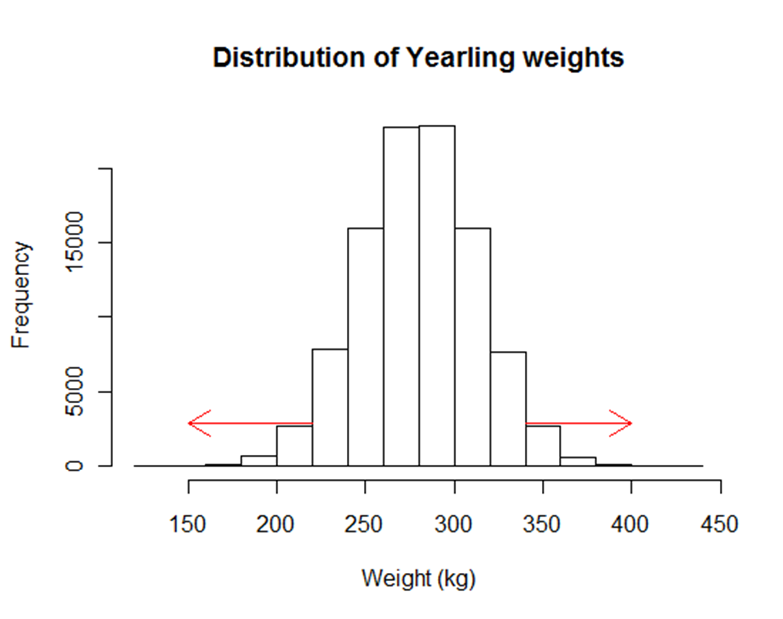
Understanding data (distributions)
Example: Normal distribution
A normal distribution is a ‘bell shaped curve’
Many tests based on it, e.g. t-test, linear regression
Symmetrical about the mean
A fixed proportion of observations are always located a certain number of standard deviations from the mean
Much biological data is normal

Slide 9
Factors affecting choice of test
Precedent/published
Regulatory body requirements
Availability and familiarity with methods
Objective of research
Statistical considerations (type and structure of data)

Slide 10
1. Precedent
= Published literature
Example:
You are looking at a faecal egg count reduction trial in sheep with an avermectin and you want a method of statistical analysis.
Search biosis previews: sheep AND avermectin AND faecal egg count reduction

Slide 11
1. Precedent: search results
Results of literature search: 6 papers
1 paper has sufficient detail in the methods for you to replicate it.
McMahon et al. 2013
The World Association for the Advancement of Veterinary Parasitology (WAAVP) guidelines indicate that arithmetic mean pre-treatment strongyle egg counts of greater than 150 epg are required in order to conduct the FECRT (Coles et al., 1992 and Coles et al., 2006). Percentage reduction was based on the formula of Kohapakdee et al. (1995): percentage reduction = [(T1 − T2)/T1] × 100, where T1 is the arithmetic mean FEC pre-treatment and T2 is the arithmetic mean FEC p.t. of treated animals. Resistance was confirmed when the reduction in FECs p.t. was less than 95% and the lower 95% confidence interval of the percentage reduction was less than 90% (Coles et al., 1992).
Here the correct ‘test’ is simply a percentage reduction with confidence intervals.

Slide 12
2. Registration body requirements
Example:
You are trying to determine what analysis you should use to determine a suitable slaughter interval for your new antibiotic.
Which test/methodology do you use?

Slide 13
2. Registration body (cont.)
One means that the Australian registration body (APVMA) uses is with regression analysis (Wang et al. 2011).
Steps:
Determine the risk of meat rejection that is acceptable to industry
Determine residue levels (~rejection risk) at various possible slaughter intervals = your trial data
Conduct regression of risk against slaughter times= ‘statistical test’
Use acceptable risk and confidence limit of regression line to determine slaughter interval = ‘significance level’

Slide 14
3. Availability and familiarity with methods
Used to using a certain method
OK if appropriate method
Available software/code/freeware
OK if appropriate method
In general, not the best method to choose.

Slide 15
4. Objective of research
Some tests suit a research objective better than others
Example:
How much does treatment reduce Salmonella infection in pigs?
 |  | Treatment category
 |  | Un-treated | Treated
Salmonella status | Infected | 60 | 45
 | Un-infected | 30 | 45

Slide 16
4. Objective of research (cont.)
Chi-squared test
Would tell you whether treatment made an overall difference
But results don’t indicate how much disease changed between the two groups so doesn’t really meet research objective
i.e. 𝝌2=5.14, d.f.=1, p=0.02

Slide 17
4. Objective of research (cont.)
Odds ratio
Would tell you whether treatment made a difference
Results also indicate how much disease changed between two groups with treatment
i.e. OR= 2.00 (95% CI: 1.09 – 3.65)
The odds of disease in untreated pigs is twice the odds of disease in treated pigs
Here choosing the second test allowed you to meet the study objective better.

Slide 18
5. Statistical considerations
Comparison group
One or multiple explanatory variables (X)
Parametric or non parametric test
If parametric choose a suitably distributed parametric test
Clustered or repeated measures data

Slide 19
Comparison Group
Some studies only collect data on one group.
Example:
A single group of animals is given a treatment and followed and data ‘analysed’
Not an ideal study, changes may not be due to treatment
No tests really possible, just a description of data
Need a comparison group for serious studies, then can compare groups and do a statistical test.

Slide 20
Number of explanatory variables
Recall that a study will always collect data on the explanatory variable of interest (often treatment)
If only a treatment variable then simple analysis (univariable). E.g. t-test
Can also collect data on multiple other variables to control confounding (e.g. sex, weight, breed etc.)
If multiple variables collected then need to do a multi-variable regression.

Slide 21
Parametric verse non-parametric test
Parametric tests are based on a certain probability distribution (e.g. normal).
To use parametric tests the data needs to be appropriately distributed
E.g. linear regression usually requires that the outcome variable is normally distributed. A Poisson regression requires count data (Poisson distribution)
Can often tell if it is appropriate based on:
the type of data, experience and by examining data
by implementing a model and looking at whether the assumptions of the model are met.
Parametric tests are often more powerful than non-parametric tests

Slide 22
Non-parametric tests
These tests do not depend upon data being distributed in a certain manner.
They are more applicable to a wide range of data types
Why don’t we always use them?
less powerful
outputs are less useful, e.g. a Mann Whitney test the same hypothesis as a t-test, but doesn’t give you an idea of how much the outcome changes between treatment groups. A t-test does.

Slide 23
Correlated data (clustering and repeated measures)
Some data has some observations that are more similar to those around them than to other observations
Two common types
Clustered data: e.g. individuals are organised in groups
Repeated measures data: An individual has two or more measurements collected in the same study
Problem: If you don’t account for this then results will generally be ‘more significant’ than they should be.
Will get type I errors, i.e. falsely conclude an effect was present.

Slide 24
What to do about correlated data
Firstly recognise it. Then get some help from a statistical consultant
Two broad ways to deal with it:
Clustered data = add a random effect to your model = so called mixed or hierarchical models
Repeated measures data = Generalised estimating equations (GEE), trend models etc
However, few vets should be expected to do this! Therefore get help!

Slide 25
Tool to choose a test
Nature of explanatory/predictor variables (independent or X) | Nature of outcome variable (dependent or Y) | Test(s)
No explanatory variables | continuous, normal | one-sample t-test
 | ordinal or continuous | one-sample median
 | categorical | binomial test
 | categorical | Chi-square goodness-of-fit
One explanatory variable with 2 levels | continuous, normal | t-test
 | ordinal or continuous | Wilcoxon-Mann Whitney test
 | categorical | Chi- square test
 |  | Fisher's exact test
One explanatory variable with 2 or more levels (independent groups) | continuous, normal | one-way ANOVA
 | ordinal or continuous | Kruskal Wallis
 | categorical | Chi- square test
One explanatory variable with 2 levels (dependent or matched groups) | continuous, normal | paired t-test
 | ordinal or continuous | Wilcoxon signed ranks test
 | categorical | McNemar
One explanatory variable with 2 or more levels (dependent or matched groups) | continuous, normal | one-way repeated measures ANOVA
 | ordinal or continuous | Friedman test
 | categorical | repeated measures logistic regression
Two or more explanatory variables (independent groups) | continuous, normal | ANOVA or linear model
 | categorical | logistic/poisson regression
One continuous explanatory variable | continuous, normal | correlation
 |  | simple linear regression
 | ordinal or continuous | non-parametric correlation
 | categorical | simple logistic regression
Mixture of continuous &/or categorical explanatory variables | continuous, normal | multiple regression
 |  | analysis of covariance
 | categorical | multiple logistic regression
 |  | discriminant analysis

Slide 26
‘Which test table’ use
Example:
Controlled trial
Outcome (Y):
sick/not sick = categorical (nominal)
Explanatory variables
Treatment (yes/no) = categorical (nominal)
Age (months) = continuous
Sex (male/female) = categorical (nominal)
Which test to use? Use table.
=Multiple logistic regression or discriminant analyses

Slide 27
Summary
Lots of tests out there!
Factors affecting choice
Precedent
Registration body
Preferences
Objective
Statistical
Type of data (e.g. ordinal, comparison group, multiple variables)
Non/Parametric- distribution
Correlated data

Slide 28
The end

