Slide 2
Spatial data management
iSIKHNAS

Slide 3
Background
Spatial data
Locations, names, boundaries of
Desa
Kecamatan
Kabupaten
Provinsi

Slide 4
Background…
Boundaries change
For example
1 desa split into two desa
Kecamatan moved from one kabupaten to another
Name of Kecamatan changed
New province created out of kabupaten from another province

Slide 5
Importance of spatial data
In iSIKHNAS
All data is linked to a location. This allows
Analysis
Mapping
Identifying area of responsibility
If location data is out of date
Cannot submit accurate data

Slide 6
The problem
Official national data from BPS
Only updated annually
Quickly out of date

Slide 7
The solution
The people that know about the changes first are the local staff
iSIKHNAS coordinators
iSIKHNAS will offer a way for kabupaten and provincial coordinators to update any changes to the spatial data directly on the web

Slide 8
Advantages
Coordinators can fix any problems immediately
Data is always accurate, using local knowledge
iSIKHNAS tracks changes in the names and boundaries over time
Historical data is mapped with old maps
New data is mapped with new maps

Slide 9
Development
System still under development
Will be launched in a few months
This training is to familiarise coordinators with the system
So they will be ready to use it once it is activated

Slide 10
Overview
Map interface – select the unit or units to change
Click on the button for the change
Provide details of changes
Save changes

Slide 11
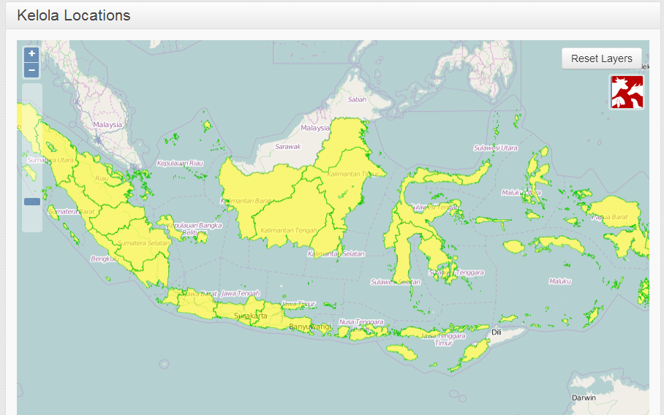
Map Interface

Slide 12
Map interface - navigation
Pan
Click and drag
Zoom in
Double click, or
Zoom slider, or
Zoom button
Zoom out
Zoom slider, or
Zoom button
Drag up to zoom in
Drag down to zoom out
Zoom slider
Zoom in
Zoom out
Zoom buttons

Slide 13
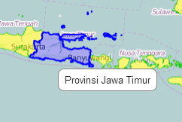
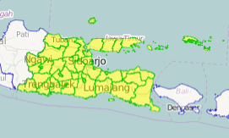
Selecting units
Float over province to see the name
It will be shown in blue
Single click on a province to select
It will be highlighted in yellow
The kabupaten will be shown in green

Slide 14
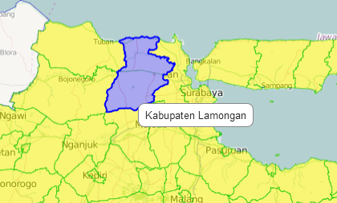
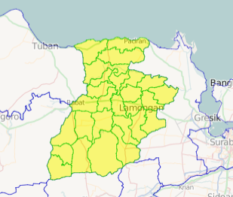
Selecting units
Zoom in to see districts better
Float to see the name
Blue highlight
Single click to select
Yellow highlight
Kecamatan boundaries will be shown

Slide 15
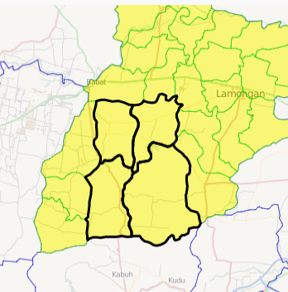
Selecting multiple units
Hold down shift key
Click on the first unit
Keep holding down the shift key
Click on the second unit
Repeat until all units are selected
Release the shift key
Selected units are outlined in black

Slide 16
Operations
Edit
Change the name of a unit
Split
Split one desa into two desa
Move
Move a unit from one parent unit to another
Merge
Merge two desa into a single desa
Create
Create a new unit from several other sub-units

Slide 17
Edit
This is used to change the name of a
Desa
Kecamatan
Kabupaten
Provinsi

Slide 18
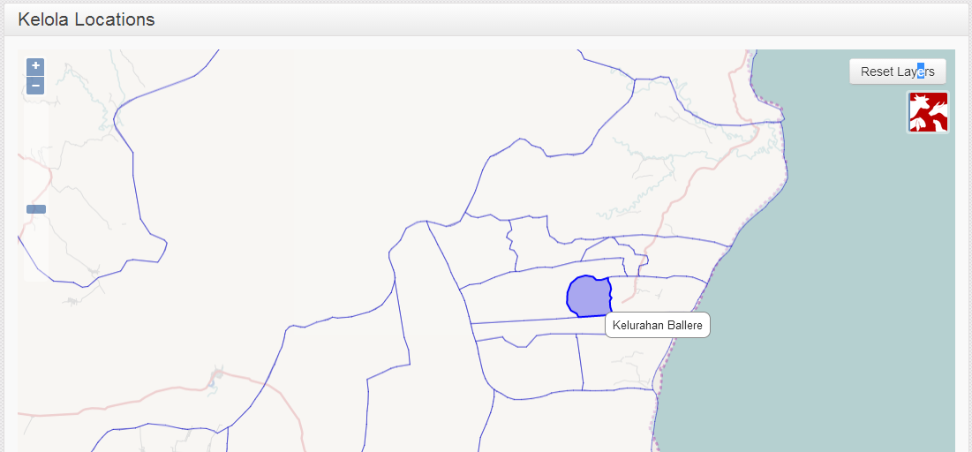
1. Select the unit on the map interface

Slide 19
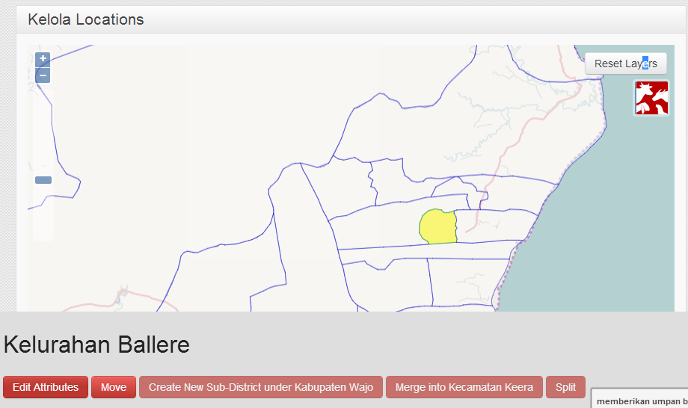
2. Click on the Edit button
Click on the Edit button

Slide 20
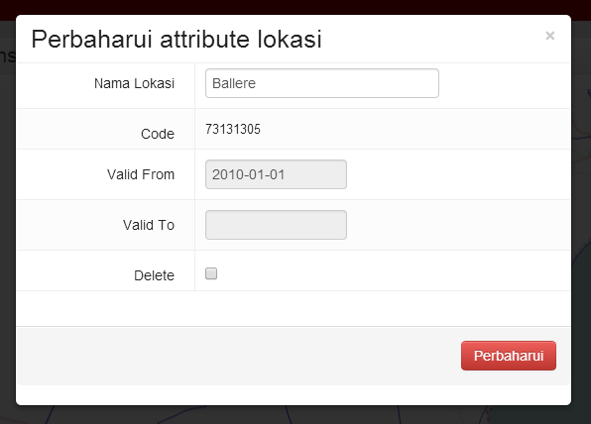
3. Edit the name

Slide 21
Split
This is used when one desa is split to become two desa (a new and an old)
You need to mark the line of the new boundary between the two desa

Slide 22
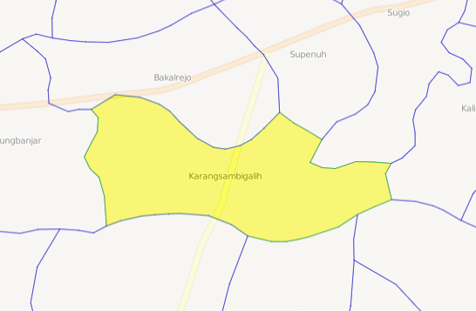
Split
Select a single desa
Only desa can be split, not higher level units
Zoom in so the desa fills most of the screen
This will make it easier to edit

Slide 23
Split
You now need to mark the line that divides the desa into two new desa
If available, copy this line from a map
The line may follow a river or a road – trace it on the map
If you don’t know, you can draw a line in the middle of the desa where you estimate the boundary should be
Try to be as accurate as possible, but don’t worry if the line not exactly right

Slide 24
Split
Click on the Split button
With the mouse, single-click on a series of points that mark the new boundary to split the desa
Start with the first point outside the desa
Then single-click points close together along the line until you get to the other side of the desa
Double-click the last point outside the desa to finish

Slide 25
Split
The system will ask you which is the new desa
Click to select the new desa
Edit the name and save

Slide 26
Move
Move is used to move a unit from one parent unit to another
For example
Move a desa to a different kecamatan
Move a kecamatan to a different kabupaten
Move a kabupaten to a different province
The moved unit will get a new location code
So will all sub-units (eg desa in a kecamatan)

Slide 27
Move

Slide 28
Move
Select one or more units to be moved
They must all be at the same level
All kecamatan, or all desa
The must all be in the same parent unit
Kecamatan in the same kabupaten
Desa in the same kecamatan
Click on the Move button

Slide 29
Move
Click on the unit to move to
This must be a parent unit
If you are moving desa, you must choose a kecamatan
If you are moving kecamatan you must choose a kabupaten
It must be next to the selected units
It must have a common boundary

Slide 30
Move
Click OK
The units will be given a new location code
The boundaries of the parent and higher units will be recalculated

Slide 31
Merge
Two desa are joined into a single desa

Slide 32
Merge
Select the two desa to merge
Only desa can be merged (not higher units)
The desa must be next to each other (share a common border)
Click on the Merge button
Select the old desa with the name that will be kept for the new desa
Click OK

Slide 33
Create
Creates a new higher-level unit from a collection of units
For example
A new province from one or more selected kabupaten
A new kabupaten from one or more selected kecamatan

Slide 34
Create
Select one or more units
They must all be at the same level
They must all be next to each other
Click Create
Enter the name for the new parent unit

