Slide 1
OTHER FEATURES and FUNCTIONS

Slide 2
Other features
You can do a few other actions in the system
Delete the last message you sent
Change your registered phone number
Find location codes

Slide 3
ADMINISTRATION FUNCTIONS: Delete last message

Slide 4
Delete the last message
H
If you make a mistake, you can send a delete message to the system.
H U = deletes the last general report
H P = deletes the last priority report
H [message start code] for any report type deletes the last message of this type.

Slide 5
OTHER FUNCTIONS: Change a phone number

Slide 6
Step 1
From the OLD number send an SMS with only the letter
N

Slide 7
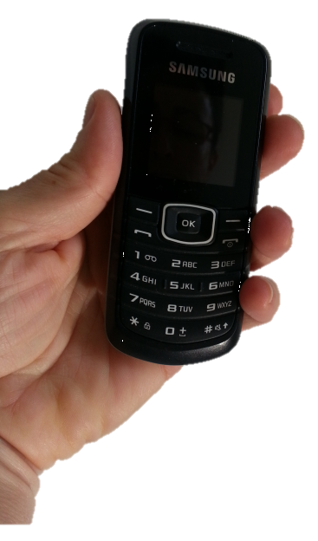
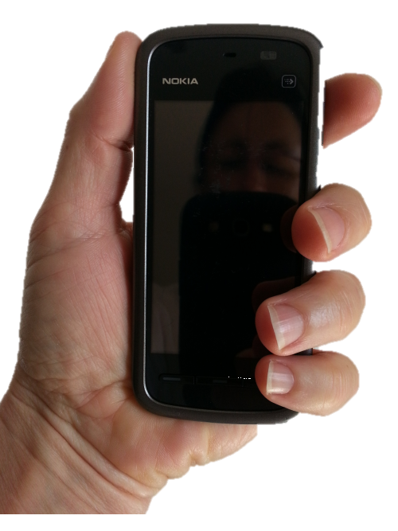
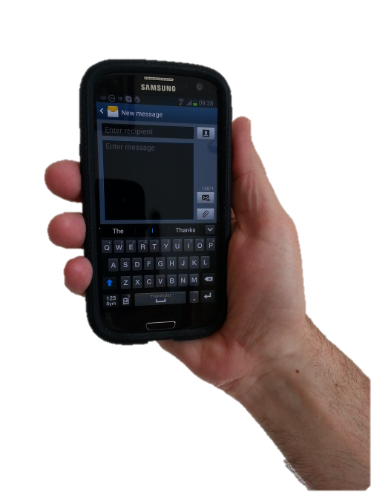
N

Slide 8
Reply
The system will send you a CODE.

Slide 9
Thank you. You would like to change your telephone number. Your secret code is 6789.
Please send N 6789 from your new telephone.

Slide 10
Step 2
From the NEW number send a message including the secret code
N [secret code]
Example: N 6789

Slide 11
N 6789

Slide 12
Thank you.
You have changed your telephone number. Your new number is 0821 23456789

Slide 13
Your old phone number is deleted from the system
Your new number is automatically stored by the system

Slide 14
OTHER FUNCTIONS: Add a new location

Slide 15
When to add a new location
L
If there is no code for the Desa in the code list, or
If the disease event is far from the centre of the Desa
Notes:
New location codes can be created using an L message.
This should be done:
If there is no code for the Desa in the code list, or
If the disease event is far from the centre of the Desa

Slide 16
New location codes
for infrastructure
Notes:
New location codes can be created to identify the exact location of certain infrastructure, such as check points, abattoirs, laboratories etc.

Slide 17
Geographical coordinates
You need to know the coordinates of the location.
Use a GPS or GPS-enabled smartphone.

Slide 18
Add a new location
L [latitude] [longitude] [name]
Example:
L -3.31932 112.39203 Hati Abattoir
In decimal degrees
Negative for south
In decimal degrees
The name of the location (e.g. dusun, farm, office)

Slide 19
L -4.6215 119.5929 Rumah Potong Bone

Slide 20
Format
The format of the coordinates should be latitude and longitude in decimal degrees,
Example:
-3.31932 112.39203
Other formats (degrees minutes seconds, degrees decimal minutes etc) are not accepted.
Use a minus sign for the latitude to indicate south, or no minus sign to indicate north.

Slide 21
Thank you. Your new location code for Rumah Potong Bone is 73090920016.

Slide 22
Location codes can also be added, changed and checked via the system website

