Slide 1
Basic Field Epidemiology
Session 10 – Making sense of the information you collect
Notes:
Facilitators notes
Step 1 – Introduction
Welcome everyone
Remind participants of the participation rules if needed

Slide 2
Notes:
Facilitators notes
This is just a reminder to facilitators that they should insert pictures into the PowerPoint file if they have pictures that are relevant. Pictures should be inserted as jpeg files in order to avoid the PowerPoint file getting large and difficult to open.
Step 1 - Introduction
Recap Session 9
Ideas on how to collect data and count cases of disease

Slide 3
In this session we will talk about:
How to describe patterns of disease by
Time
Place
Animal
How to use this information to think about causes and control strategies
Notes:
Facilitators notes
Step 1 - Introduction
Introduce the key content that is to be presented and discussed during this session

Slide 4
Activity
Task for everyone to do:
Look at the 3 epidemic curves. Each shows a count of the number of new cases of disease (vertical axis) and time in days (horizontal axis).
Can you use simple words to describe each of the 3 patterns over time?
“the number of cases is ….”
Notes:
Facilitators notes
Step 2 - Curiosity raising activity
It is important to get participants in the right frame of mind for learning.
By raising their interest or curiosity, checking their current understanding in this way, prior to the video you are preparing them to listen more intently.
They are focussing their minds on the topics about to be discussed in the video.
Ask the group to think about the question
Then get the participant to discuss some of the ideas they have…
After the video there will be time for the participants to reflect on this activity and discuss as a group.

Slide 5
Video
Show recorded PowerPoint file for Session 10
Notes:
Facilitators notes
Step 3: Play video or recorded PowerPoint file or present content
Show video or recorded PowerPoint

Slide 6
After watching the recorded PowerPoint
In this video we learnt about
How to describe patterns of disease
Different control strategies
Task for everyone to do:
Revisit your ideas to questions prior to the video.
Have your views changed?
Notes:
Facilitators notes
Step 4: Discuss content of recorded PowerPoint file
Make sure everyone has a clear understanding of the content. Refer to the Resource Manual for more information.
Ask the participants if anyone wants to talk about …
Ask the participants to reflect on their answers to the activity before the video.
Ask the participants to put their hands up if they have changed their view on what is a cause or if they will think in new ways since watching the video
Always make sure participants have no unanswered questions or confusions before you go forward.

Slide 7
Group activity – Investigation of abortions in pigs Background information
We developed a case definition in Session 9.
Investigation:
16 farms provided data on all sows that farrowed over a 4-month period.
Para-vet visited each farm to check sows and make sure that good data were collected on cases and non-cases
2 farms had no sows farrow in that time so had no data.
Next sheet shows the data that were collected
Case = sow that aborted (Abortion = Yes)
Notes:
Facilitators notes
Step 5 – Group activity – Investigation of abortions in pigs
First ask the participants to read the background information to set the scene
Remind the participants of the case definition the group had agreed on from Session 9

Slide 8
Data from 14 pig farms
Report number | Farm | Date | Abortion | Age of sow
1 | 2 | 1/01/2014 | Yes | 4
2 | 7 | 1/01/2014 | Yes | 1
3 | 12 | 25/01/2014 | No | 3
4 | 8 | 28/01/2014 | Yes | 2
5 | 16 | 10/02/2014 | No | 6
6 | 7 | 20/02/2014 | Yes | 1
7 | 7 | 20/02/2014 | Yes | 2
8 | 3 | 28/02/2014 | No | 8
9 | 11 | 1/03/2014 | No | 5
10 | 8 | 5/03/2014 | Yes | 2
11 | 9 | 15/03/2014 | No | 6
12 | 5 | 17/03/2014 | No | 3
13 | 10 | 17/03/2014 | No | 4
14 | 8 | 25/03/2014 | Yes | 1
15 | 7 | 30/03/2014 | Yes | 1
16 | 15 | 5/04/2014 | No | 7
17 | 12 | 5/04/2014 | No | 5
18 | 16 | 7/04/2014 | Yes | 6
19 | 6 | 15/04/2014 | No | 3
20 | 1 | 18/04/2014 | No | 1
21 | 13 | 22/04/2014 | No | 5
22 | 7 | 25/04/2014 | Yes | 2
23 | 9 | 25/04/2014 | No | 6
24 | 2 | 27/04/2014 | No | 3
25 | 8 | 28/04/2014 | Yes | 2
26 | 11 | 29/04/2014 | No | 4
Data over 4 months
All sows that farrowed on each of 16 farms
One row for each sow
Abortion = Yes = case
Abortion = No = farrowed normally
2 farms had no sows farrow so data collected on 14 farms
Notes:
Facilitators notes
Step 5 – Group activity – Investigation of abortions in pigs
The group will need to copy this information or it can be written up on a flipchart

Slide 9
Group Activity
Report number | Farm | Date | Abortion | Age of sow
1 | 2 | 1/01/2014 | Yes | 4
2 | 7 | 1/01/2014 | Yes | 1
3 | 12 | 25/01/2014 | No | 3
4 | 8 | 28/01/2014 | Yes | 2
5 | 16 | 10/02/2014 | No | 6
6 | 7 | 20/02/2014 | Yes | 1
7 | 7 | 20/02/2014 | Yes | 2
8 | 3 | 28/02/2014 | No | 8
9 | 11 | 1/03/2014 | No | 5
10 | 8 | 5/03/2014 | Yes | 2
11 | 9 | 15/03/2014 | No | 6
12 | 5 | 17/03/2014 | No | 3
13 | 10 | 17/03/2014 | No | 4
14 | 8 | 25/03/2014 | Yes | 1
15 | 7 | 30/03/2014 | Yes | 1
16 | 15 | 5/04/2014 | No | 7
17 | 12 | 5/04/2014 | No | 5
18 | 16 | 7/04/2014 | Yes | 6
19 | 6 | 15/04/2014 | No | 3
20 | 1 | 18/04/2014 | No | 1
21 | 13 | 22/04/2014 | No | 5
22 | 7 | 25/04/2014 | Yes | 2
23 | 9 | 25/04/2014 | No | 6
24 | 2 | 27/04/2014 | No | 3
25 | 8 | 28/04/2014 | Yes | 2
26 | 11 | 29/04/2014 | No | 4
Work in small groups
Answer the following questions
Using these data, make an epidemic curve to show number of cases over time (per day).
Discuss what the epidemic curve can tell you about the problem.
Notes:
Facilitators notes
Step 5 – Group activity – Investigation of abortions in pigs
Each group is now to work through the following questions
Participants are to write the answers to the questions on scrap paper
Ask them to let you know when they think they have finished
Go around the room and monitor their progress

Slide 10
Group activity – abortions in pigs
Make an epidemic curve to explore this disease problem over time.
Notes:
Facilitators notes
Step 5 – Group activity – Investigation of abortions in pigs
Question 1
Vertical axis (y-axis) shows a count of the number of cases each day
Horizontal axis shows the date or day

Slide 11
Group activity – Investigation of abortions in pigs
Discuss what information this epidemic curve can tell us about the problem.
Notes:
Facilitators notes
Step 5 – Group activity – Investigation of abortions in pigs
Question 2
The epidemiological curve does not show a typical rise and fall pattern as seen with outbreaks of contagious disease in a susceptible population.
This epidemic curve could be due to an endemic disease (relatively stable over time) and may reflect the normal background rate of abortions.
An endemic disease would produce a relatively level pattern of disease over time as seen here.

Slide 12
Group activity –abortions in pigs
This map shows the farms included in the investigation. Marking which farms had disease is a way of looking at where the disease has occurred.
What can you say about place – where the disease has occurred?
Consider where affected farms and unaffected farms are, and which farms are most affected.
16
15
14
1
4
13
2
12
River 1
3
5
8
6
7
9
11
River 2
10
Notes:
Facilitators notes
Step 5 – Group activity – Investigation of abortions in pigs
Each group is now to work through the questions
Participants are to write the answers to the questions on scrap paper

Slide 13
Group activity – Investigation of abortions in pigs
What can you say about place – where the disease has occurred?
16
15
14
1
4
13
2
12
River 1
3
5
8
6
11
River 2
7
9
10
Notes:
Facilitators notes
Step 5 – Group activity – Investigation of abortions in pigs
Question 4
Of the 14 farms that met the case definition and were included in the investigation data was collected on a total of 26 sows.
11 of 26 (42%) sows aborted and 15 (58%) sows farrowed.
The 11 sows that aborted came from 4 of the 14 farms (farms- 2, 7, 8, and 16).
Farms 7 and 8 accounted for 9 of the 11 abortions (82%).

Slide 14
Group activity – Investigation of abortions in pigs
Describe the disease problem by host characteristics – age
Discuss how looking for patterns of disease has helped you develop ideas about possible causes.
Calculate attack rate of abortion for sows 1 and 2 years of age and compare this with the attack rate for sow older than 2 years of age.
Draw conclusions on the investigation up until this point. Outline your ideas of possible causes of disease. What ideas do you have for further disease investigations?
What possible disease control measures are there?
Notes:
Facilitators notes
Step 5 – Group activity – Investigation of abortions in pigs
Each group is now to work through the following questions
Participants are to write the answers to the questions on scrap paper
Ask them to let you know when they think they have finished
Go around the room and monitor their progress

Slide 15
Group activity – Investigation of abortions in pigs
Describe the disease problem by host characteristics – age, age group
Notes:
Facilitators notes
Step 5 – Group activity – Investigation of abortions in pigs
Question 4
The 26 pigs ranged from 1 year of age to 8 years of age.
There were 4 abortion in 1 year old sows, 5 abortion in 2 year old sows, 1 abortion in a 4 year old sow, and 1 abortion in a 6 year old sow.
1 and 2 year old sows accounted for 9 (82%) of the abortions.
All the 1 and 2 year old sows came from farms 7 and 8.

Slide 16
Group activity – Investigation of abortions in pigs
Discuss how looking for patterns of disease has helped you develop ideas about possible causes.
Most of the cases are from farms 7 and 8
Most abortions are in pigs 1 or 2 years of age.
Notes:
Facilitators notes
Step 5 – Group activity – Investigation of abortions in pigs
Question 5
From the simple analysis above we can get a better understanding of the disease problem and possible causes.
By looking for patterns in time, animal, and place we can get the following insights
Most of the cases are from farms 7 and 8. May be there is something happening on these two farms that is causing increased disease occurrence
Most abortions are in pigs 1 or 2 years of age.
The abortions on farms 2 and 16 may be due to other background causes. The aborting sows on farms 2 and 16 are 4 and 6 years old, respectively.
The aborting sows on farms 7 and 8 are all young sows. Also farms 2 and 16 are not in close proximity to farms 7 and 8
It would be interesting to see if there is any link between farms 7 and 8 and farms 2 & 16.

Slide 17
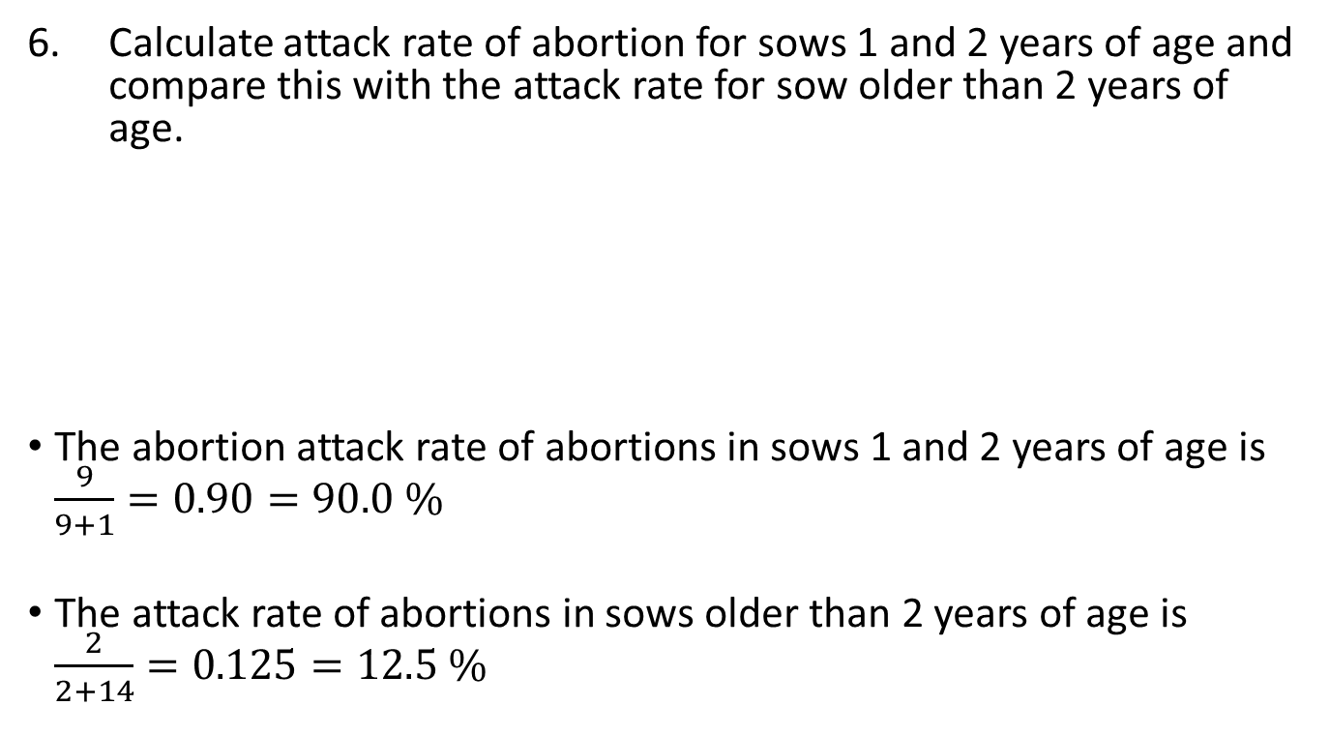
Group activity – Investigation of abortions in pigs
Calculate attack rate of abortion for sows 1 and 2 years of age and compare this with the attack rate for sow older than 2 years of age.
The abortion attack rate of abortions in sows 1 and 2 years of age is $\frac{9}{9+1}=0.90=90.0 \%$
The attack rate of abortions in sows older than 2 years of age is $\frac{2}{2+14}=0.125=12.5 \%$
Notes:
Facilitators notes
Step 5 – Group activity – Investigation of abortions in pigs
Question 6
The abortion attack rate of abortions in sows 1 and 2 years of age is $\frac{9}{9+1}=0.90=90.0 \%$
The attack rate of abortions in sows older than 2 years of age is $\frac{2}{2+14}=0.125=12.5 \%$
Advanced extension to this question:
We can compare these two numbers as 90% vs. 12.5% or we can calculate a Relative Risk.
This is interpreted as sow that are 1 or 2 years of age are 7.2 times more likely to have an abortion. $\frac{0.9}{0.125}=7.2$

Slide 18
Group activity – Investigation of abortions in pigs
Draw conclusions on the investigation up until this point. Outline your ideas of possible causes of disease. What ideas do you have for further disease investigations?
Notes:
Facilitators notes
Step 5 – Group activity – Investigation of abortions in pigs
Question 7
Conclusions:
Data collected on 26 sows from 14 farms.
11 (42%) sows aborted.
The 11 sows that aborted came from 4 farms (farms- 2, 7, 8, and 16).
Farms 7 and 8 accounted for 9 of the 11 abortions (82%).
The 26 pigs ranged from 1 year of age to 8 years of age.
Most abortions occurred in young sows.
1 and 2 year old sows accounted for 9 (82%) of the abortions.
All the 1 and 2 year old sows came from farms 7 and 8.
The epidemic curve shows a stable pattern, consistent with endemic disease.
We might expect younger animals to be more susceptible and older animals to be more likely to be immune.
This could explain why most of the disease is occurring in younger sows.
Some sows that were not exposed as younger animals might still be susceptible at older ages and this could explain the few cases in older sows.
OR, the older sows may have aborted due to some other disease.
It would be useful to look for links between farms 7&8 and farms 2&16 to see if there might be some activity that could have spread disease (movement of pigs, people or equipment).
Possible cause of disease could be
Endemic disease
You would need to talk to a veterinarian to identify possible infectious diseases that might be present in your area
Nutritional causes
Is there any evidence that younger sows received different feed to older sows (poorer feed or spoiled feed)
Management causes
Are younger sows managed differently to older sows – different housing, kept in different areas, access to toxins
At this stage it would be useful to have a discussion with experts - Dinas veterinarian, veterinary epidemiologist, pig disease expert and consider additional investigations such as:
Visits to affected farms to look in detail at pigs, feed, water, environment etc
Review case material and revisit case definition and compare to known diseases – refine differential diagnosis list
Are there any laboratory tests that might be helpful for diseases on the differential diagnosis list
If more sows are due to farrow on affected farms, can you prepare for abortions and get samples for post mortem

Slide 19
Group activity – Investigation of abortions in pigs
What possible disease control strategies can be implemented?
Notes:
Facilitators notes
Step 5 – Group activity – Investigation of abortions in pigs
Question 8
Possible initial disease control strategies include:
Control of animal movements:
Unaffected farms should avoid bringing in new pigs into their farms until this investigation is over
Affected farms should not to move pigs off their property until the investigation is concluded or until after cases have stopped occurring. If it is an infectious causes then reducing the number of infected properties and therefore total number of infected animals is useful.
Other biosecurity measures:
Management
Make sure farrowing areas are clean and dry and that all animals are getting good feed and clean water
Make sure animals are healthy before moving them onto or off a farm to avoid spreading disease
Quarantine new arrivals to make sure they are healthy before mixing them with other animals
Keep young sows and old sows separate to prevent possible spread of infection between groups
Treatments?
If you felt the cause was likely to be a bacterial infection then antibiotic treatment of aborting sows and possibly in-contact pregnant sows may be helpful

Slide 20
In this session we talked about:
How to describe patterns of disease by
Time
Place
Animal
Control strategies
Notes:
Facilitators notes
Step 6 – Summary of session
Ask if there are any questions or confusions
Always make sure participants have no unanswered questions or confusions before you go forward.

Slide 21
Key concepts of session 10
Better animal health
for Indonesia
Learn new skills
Describe disease in terms of:
Time (epi-curves)
Animal (whole numbers, proportions)
Place (mapping)
This understanding of disease will help us to develop control strategies which include
Control of animal movement
Animal management – housing, feed, handling, water
Treatment of sick and possibly contact animals
Isolation of sick animals or at risk animals
Hygiene
Quarantine
Have fun
Improve your
job satisfaction
Notes:
Facilitators notes
Step 6 – Summary of session
Highlight the key concepts that were talked about in this session.
If time allows discuss any points that are raised

